Slide 1
web scraping
Ubanesh N

Slide 2
Introduction to Web Scraping
Definition: Web scraping is the automated process of extracting data from websites. It involves fetching the HTML content of a webpage and then parsing it to extract the desired information.
Importance: In today's digital age, vast amounts of data reside on the web. Web scraping allows businesses, researchers, and individuals to access and utilize this data for various purposes, including market analysis, competitive intelligence, research, and more.

Slide 3
Basic HTML Structure
Content:
The HTML structure of the web scraping form is fundamental to its functionality.
Key HTML elements are utilized to create the form for inputting the URL and submitting the
request for scraping.
Elements:
<form>: Encloses the form elements and specifies the method (POST) and action
(scrape.php) attributes.
<input type="text">: Allows users to input the URL to be scraped. Placeholder
text provides guidance.
<button type="submit">: Triggers the submission of the form when clicked, initiating
the scraping process.

Slide 4
CSS Styling
Content:
CSS styling plays a crucial role in enhancing the visual appeal and usability of the web scraping form.
Well-designed CSS ensures a consistent and intuitive user interface, improving overall user experience.
Styling Attributes:
Background Color: Sets the background color of the form to #fff (white).
Padding and Border Radius: Adds padding and rounded corners to the form, enhancing its visual appeal.
Box Shadow: Creates a subtle shadow effect around the form, providing depth and dimension.
Width and Alignment: Specifies the width of the form and centers it horizontally on the page.
Text Styling: Defines the font family, text color, and alignment for improved readability.

Slide 5
PHP Implementation - Handling Form Submission and Web Scraping
Content:
The PHP script manages form submission and initiates the web scraping process seamlessly.
Form Submission Handling:
Utilizing PHP's $_SERVER["REQUEST_METHOD"] to detect form submission.
Sanitizing and validating the input URL using filter_input() function with FILTER_SANITIZE_URL
and FILTER_VALIDATE_URL filters.
Web Scraping Process:
Retrieving HTML content from the provided URL using file_get_contents() function.
Parsing HTML content using PHP's DOMDocument class to extract relevant data.
Database Interaction:
Storing the scraped data, such as headlines, in a MySQL database for future reference
or analysis.

Slide 6
Storing Scraped Data in a MySQL Database
Content:
After extracting data from the HTML content, the next step is to store it in a MySQL database for future retrieval and analysis.
Database Configuration:
Includes servername, username, password, and database name needed to establish a connection to the MySQL database.
Database Interaction:
Utilizing PHP's MySQLi extension to interact with the MySQL database.
Prepared statements are used for secure and efficient execution of SQL queries.

Slide 7
Executing SQL Queries and Error Handling
Content:
After establishing a connection to the MySQL database, the PHP script executes SQL queries to insert scraped data and handles any potential errors.
Executing SQL Queries:
Prepared statements are utilized to execute SQL queries safely and efficiently.
Data such as the URL and extracted headlines are inserted into the database table.
Error Handling:
Proper error handling mechanisms are implemented to manage potential issues during SQL query execution.
Error messages are displayed to provide feedback to the user or for debugging purposes.

Slide 8
Conclusion
Content:
This presentation has provided a comprehensive overview of web scraping with PHP, covering its fundamental concepts, implementation techniques, and practical applications.
Key Takeaways:
Understanding Web Scraping: We've explored the process of extracting data from websites, leveraging PHP's powerful features such as DOMDocument and MySQLi for efficient data retrieval and storage.
Implementation Guidelines: Best practices for handling form submission, parsing HTML content, interacting with databases, and error handling have been discussed to ensure secure and reliable web scraping operations.
Value of Data-driven Insights: By harnessing the capabilities of web scraping with PHP, businesses, researchers, and individuals can gain access to valuable data for market analysis, research, competitive intelligence, and more.

Slide 9
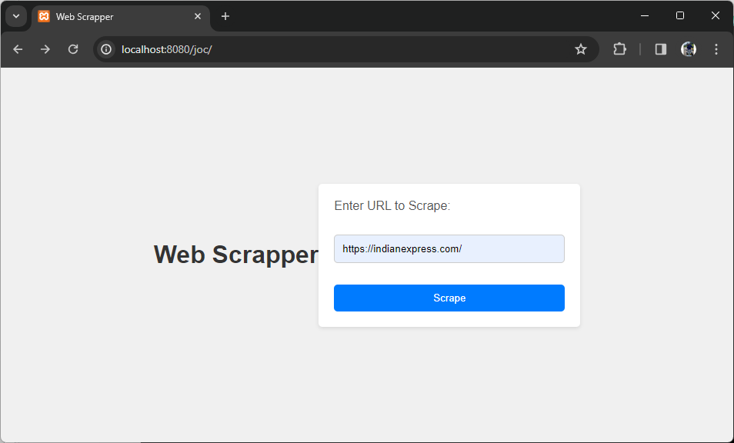
Screenshots

Slide 10
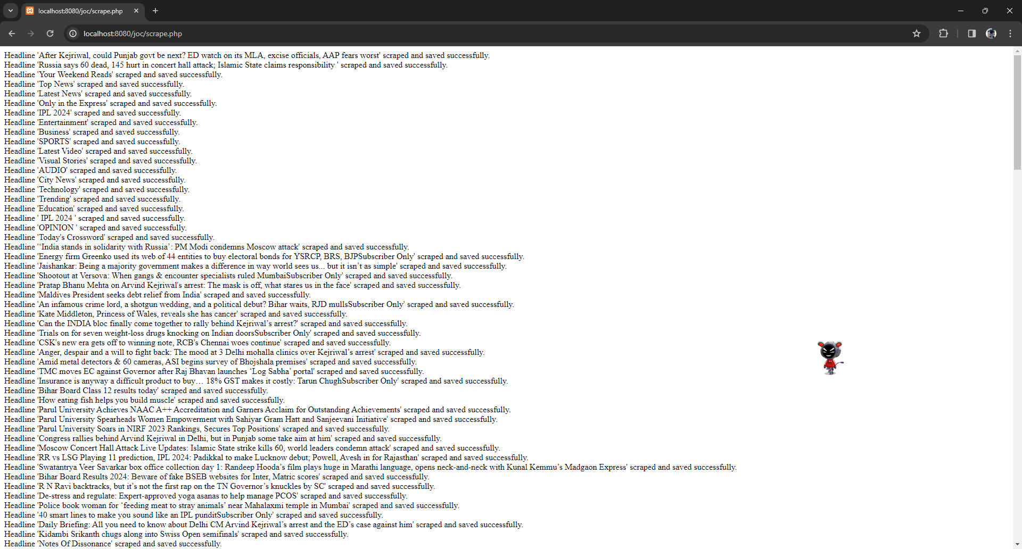

Slide 11
